Slide 1
#ABC Ltd
#WeAreHiring
#DigitalTrasformation
#Industry 4.0

Slide 2
#Best-In-Class-Compensation
#Transformation-Starts-With-You

Slide 3
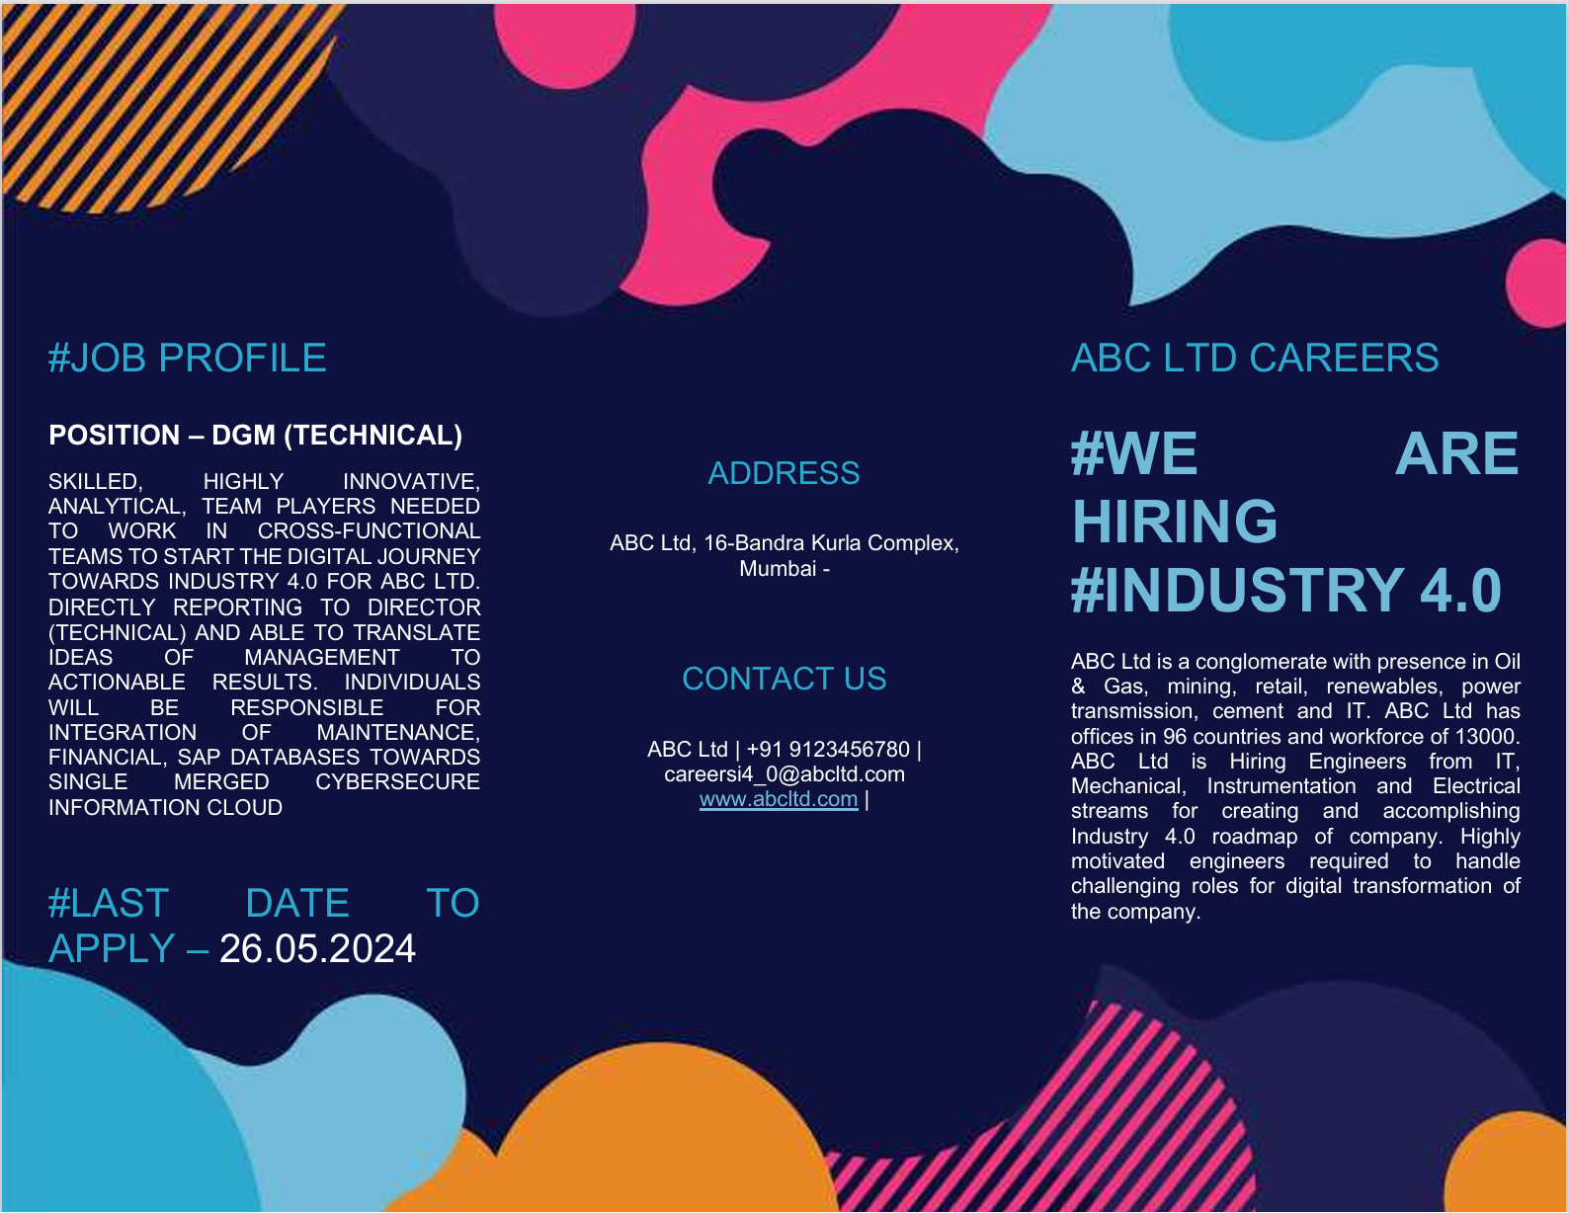

#GrowWithUs

